Slide 1
How Can We Deal with Risks from the Internet: Why Privacy Legislation Is Hot Right Now
Professor Peter Swire
Ohio State University/Center for American Progress
5th TransAtlantic Market Conference: Protecting Critical Technology & Infrastructure
October 16, 2011

Slide 2
The Internet Then

Slide 3
The Internet Now

Slide 4
Overview
Privacy legislation:
U.S. - Numerous bills, hearings now, most in a decade
E.U. - Directive update, first since 1995
Theme:
E.U. pattern of broad privacy laws, based on human rights, with exceptions in practice
U.S. pattern of narrow laws, based on consumer protection, with extra enforcement through jawboning and the press
Why now?
How to draw on the best of both worlds?

Slide 5
Brief History
German and other national data protection laws in 1970s and 1980s
Twin goals of the E.U. Directive, 1995/1998
Assure transborder data flows within EU
Permit only legitimate processing of personal information
Data to other countries only if “adequate” protection
U.S. laws
Sectoral laws since 1970 (Fair Credit Reporting Act)
HIPAA, GLB, children’s online in late 90’s
FTC enforces for “deceptive” practices online
But, no framework legislation
EU/US “Safe Harbor” in 2000
Many E.U. protections, but with clarity on practical exceptions
Privacy less prominent after 9/11, but implementation continued

Slide 6
Changing Privacy Challenges
1990s – the Internet
User goes to a web site
Privacy policies created in 1990s
Now
Social networks
Mobile privacy – location based services
Online behavioral advertising & “tracking” across sites

Slide 7
Social Networking
Facebook was founded 7 years ago
Today, over 500 million users/day
What privacy controls and laws for social media?

Slide 8
Legal Response to Social Networking
U.S.
Legislative hearings, but no legislation
No “deception” enforcement to date
Lots of public commentary, market pressures (new competitors) will help preserve privacy
E.U.
Schleswig-Holstein ordered all businesses in that state “to shut down their fan pages on Facebook and remove social plug-ins such as the ‘like’-button from their websites.”
Irish DPA announces comprehensive privacy audit of Facebook after “Europe vs. Facebook” lists 22 violations of E.U. privacy law

Slide 9
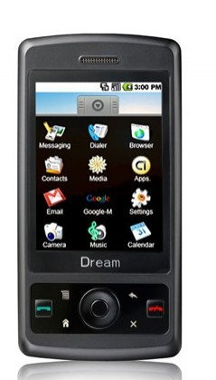
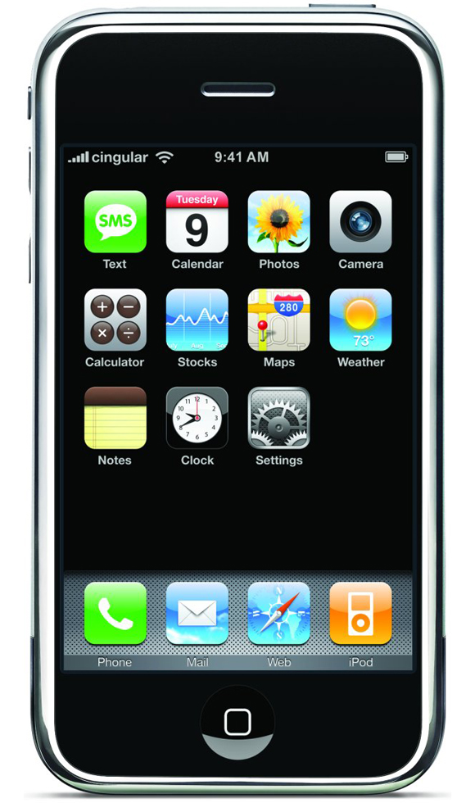
Mobile privacy
Not long ago few people carried cell phones
Today they are pervasive globally
They track our location.
What are the privacy issues?

Slide 10
Mobile Privacy
U.S.
No legislation to date
Hearings on Apple/Google – surprise that phones were mapping location
Small % of aps that collect location information had any privacy policy, spring 2011
Self-regulatory effort now by FPF/CDT and industry
E.U.
Article 29 Working Group
Opt in consent, specific to location
General data protection rules apply to location information

Slide 11
Online Behavioral Advertising
U.S.
Steady push from FTC for industry self regulation
Browser modifications for user control
Opt out icon on ads
WSJ and other scrutiny of “What They Know”
New laws?
“Do Not Track” suggested by FTC – limit display of targeted ads, maybe more
DNT for Kids legislation proposed
Privacy advocate concern that built-in technology will over-collect and use information, with few safeguards on how data is used
Concern about possible under-reaction by legal system to major increase in tracking

Slide 12
The EU Cookie Law in 2.5 Minutes

Slide 13
OBA and Trans-Atlantic
U.S. and slow ramp up of self-regulation
Significant press and political concern
Legislation difficult – few things pass Congress
E.U. and possible dual Internet
Will sites in U.K. put up all those notices?
Reminds me of 1998-2000
U.S. and interest in stronger government response
E.U. and criticism that regulation outstrips what is practical or desirable
Renewed Trans-Atlantic dialogue on privacy and data

Slide 14
Why Internet Rules Matter Today

Slide 15
Conclusion
How get the best results from European scrutiny of industry practices?
Don’t just say “individual rights” but work toward practical solutions
Much easier to say “opt in” instead of “opt out” than it is to build the systems that do it, especially for OBA
How get the best results from U.S. innovation and benefits to users?
Social networks
Mobile
Internet eco-system that provides free content
I suggest government-level engagement, together with privacy agency engagement, to seek the best from both approaches
Keep the current “Safe Harbor” but consider how to update for today’s issues
Together, imagine how to get a wonderful Internet for individuals, and also for economies on both sides of the Atlantic

