Slide 1


Privacy, Cybersecurity, and Meeting Business Goals in the Post-Snowden World
British American Business Council Conference
May 22, 2014
Peter Swire
Huang Professor of Law and Ethics

Slide 2
Overview of the Talk
My background
President Obama’s Review Group on Intelligence & Communications Technology
Privacy, Cyber-security After Snowden
  Data breach – Target, HIPAA
  Big data – new White House report
  Government access to your data post-NSA
EU and US on privacy
  Global challenges to your business models

Slide 3
Swire Background
Clinton Administration:
  Chief Counselor for Privacy
  Government’s own use of personal information
    Web site policies and congressional oversight
    88/89 = flunk (?)
  HIPAA, GLBA, online privacy, government access
Morrison & Foerster, 2001-2008
Advisory boards on privacy & cyber-security:
  Microsoft, Intel, Strevus and other start-ups
Practical compliance for government & industry
  Can provide that to clients going forward

Slide 4
Creation of the Review Group on Intelligence and Communications Technology
Snowden leaks of 215 and Prism in June, 2013
August – Review Group named
Report due in December
5 members

Slide 5
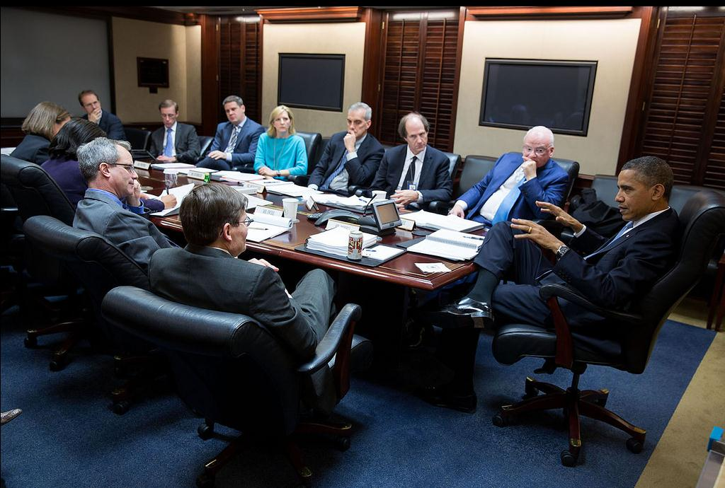
December 2013: The Situation Room

Slide 6
Our assigned task
Protect national security
Advance our foreign policy, including economic effects
Protect privacy and civil liberties
Maintain the public trust
Reduce the risk of unauthorized disclosure

Slide 7
Our Report
Meetings, briefings, public comments
300+ pages in December
46 recommendations
  Section 215 database “not essential” to stopping any attack; recommend government not hold phone records
Pres. Obama speech January
  Adopt 70% in letter or spirit
  Additional recommendations under study

Slide 8
RG: One Internet, Multiple Equities
The same Internet for:
  Intelligence, law enforcement
  E-Commerce
  Free speech & political dissent
  All the fun stuff – cat videos
  Military theaters of combat

Slide 9
Some Effects Since June
U.S. intense debates post-Snowden about surveillance vs. privacy, civil liberties, and other values
Effects on allies – Merkel, Brazil
Cloud computing & other U.S. business interests
  Marketers: “US cloud providers have to give all the customer data to the NSA, so buy our local services”
Internet governance
  U.S. Internet Freedom agenda vs. surveillance
  U.S. leadership in Internet governance under new challenge

Slide 10
Addressing National Security
Unanimous report, signed off by 30-year veteran of the CIA & a top anti-terrorism official
We had expert staffing and briefings by the agencies
RG Rec 15: we recommended fixing a gap in current NSA authorities when a suspect enters US and hasn’t been picked up yet by the FBI

Slide 11
Addressing Privacy & Civil Liberties
RG: Numerous proposed changes to U.S. law and institutions:
  End current Section 215 program (and administration now agrees)
  More judicial oversight
  Public advocate participates in the secret court
  Stronger tech capability for the court and the Privacy & Civil Liberties Oversight Board
In my view, significant progress and Congress may go further

Slide 12
Addressing Business & the Economy
Greater inclusion of economic policy-makers in a range of settings
RG Rec 9: Address the top IT industry request – transparency report
  DOJ agreement with companies in January

Slide 13
Addressing Foreign Affairs/Allies
RG Rec 19: New process for surveillance of foreign leaders
Presidential Policy Directive 29:
  Historically, for surveillance, countries have provided much stronger protections for their citizens than in other countries
  PPD-29 a milestone, with “minimization” of data for non-US persons
    Big new software project to build that
  Details far from clear, but a notable shift

Slide 14
Summary on One Internet, Multiple Equities
In addition to national security, have crucial other equities:
  Strengthen cyber-defense
  Privacy & civil liberties
  Business and the economy
  Allies
  Internet governance
Make US policy in the context of these other equities

Slide 15
Overview of the Talk
Background for compliance
President’s Review Group
Privacy, Cyber-security after Snowden
  Data breach
  Big data
  Government access
US and EU on privacy

Slide 16
Data Breaches
Growing business compliance issue
Target’s breach
  Stock price down; CEO gone
  Many lawsuits
  Admitted knew of security weakness but thought it wasn’t worth implementing fix …
HIPAA and online health records since 2009
  NY Presbyterian Hospital and Columbia, $4.8 million
EU: IT sector now and everyone later

Slide 17
Business Management and Data Breaches
Need tech & lawyers & compliance people
Before the breach
  Draft cyber policies
  Assign responsibilities
  Follow them
After the breach
  Draft the notice to consumers: law
  Forensics/tech
  Opportunity for new compliance regime

Slide 18
Big Data, Analytics & Compliance
How many of you have big data or analytics initiatives now in your company?
To date: quant experts & marketing
Tomorrow: source of privacy & security risk
  Data breach – big data can mean big breach
  Podesta Big Data report
    Transparency & follow your stated policies
    Discrimination (Boston potholes story)
  If identified data to third parties, may be your responsibility – contracts, de-identify the data
  Big trends tend to become compliance issues

Slide 19
Government Access to Company Data
Since 9/11 – how can we help?
Post-Snowden – more caution unless legally required
Non-US customers – don’t store in the US to avoid giving to the NSA
  Microsoft cloud server in Ireland
  DOJ wants the email there
  Magistrate said US legal process applies
  On appeal

Slide 20
Government Access & Compliance
Your policies on handing it over:
  At your discretion?
  Only when legally mandated?
  Prior notice to customers?
Enterprise & non-US customers wanting stronger assurances
How create compliance with your policies?
  E.g., former government IT person or prosecutor is your employee and wants to help the police
Shifting to post-Snowden business realities

Slide 21
Overview of the Talk
Background for compliance
President’s Review Group
Privacy, Cyber-security after Snowden
  Data breach
  Big data
  Government access
US and EU on privacy

Slide 22
Background on EU & US Privacy
UK 1984 privacy law
EU Data Protection Directive (in effect 1998)
  Free flow of data within common market
  Limits to other countries that lack privacy laws
Safe Harbor 2000
  Companies certify to much of the Directive
  Then, is “adequate” for EU purposes
  After slow start, thousands of companies today
  Enforcement in US by the FTC
  Post-Snowden, EU threatens to cancel Safe Harbor

Slide 23
Proposed Data Protection Regulation
Globally, 100+ countries now with privacy laws
  Get “adequacy” under EU law
Proposed EU Data Protection Regulation
  Strengthen privacy laws
  Uniform across the EU
  Fines up to 2% of global revenue
    Even big companies would feel this pain
Will it become law?
  Draft Regulation to strengthen seemed to be blocked
  Post-Snowden, 621-10 vote in EU Parliament

Slide 24
Right to be Forgotten
Draft regulation has “right to be forgotten”
  Spanish case – 14 year old press story on foreclosure
  European Court of Justice: Google last week
    Stays in newspaper archive
    Search engines (at least) must suppress links unless public’s right to know outweighs privacy considerations
    Great uncertainty how this right will apply
Contrast US law
  First Amendment is a local ordinance
  But, we do have Fair Credit Reporting Act

Slide 25
Privacy compliance and global challenges
Companies would like to have legal harmonization EU/US/Asia
  Not on the horizon
  Even harder post-Snowden when EU is angry on privacy
If no harmonization, develop compliance strategy:
  When to have separate systems US and outside?
  When to level up to EU rules?
  When to adopt risk-based approach to historically modest EU fines?

Slide 26
Conclusion (1)
Change in assumptions post-Snowden for government access
Data breaches & Big Data increasing issues in private sector
Global compliance challenges with 100+ laws
Who has visibility into the privacy and cyber-security risks facing your company?
  Map the data flows
  Update your policies about data flows
  Build and enforce compliance systems
  Be informed about the risks and manage them

Slide 27
Conclusion (2)
Data a larger and larger part of the value of your company
Risks to data become more material
Privacy and security will continue to grow as compliance issues
Get your team for tech + law + compliance
Be ready for the challenges to come
  At least the issues are really interesting!
Thank you.

Slide 28
Contact Information
Professor Peter Swire
www.peterswire.net
peter@peterswire.net
Ph: 240.994.4142

